Slide 1



Adventures in Youth Entrepreneurship:
The Young Entrepreneurs Academy (YEA!)
Presented by Carolyn DeJohn And Tressa Labella
Notes:
Introduce ourselves to the audience

Slide 2

YEA! – The Basics
https://www.youtube.com/watch?v=agkHrYoe4A4&list=UUAvR2Vol4v903dyEP71JEhA
Notes:
Overview of YEA: The Young Entrepreneurs Academy (YEA!) is a groundbreaking and exciting after-school program that transforms local middle and high school students into real, confident entrepreneurs. Through the year long program, students generate business ideas, conduct market research, write business plans, and then pitch business ideas to a panel of investors for funding to launch their very own real businesses. The class is held at MVCC Utica Campus from 4pm to 7pm on Wednesday nights, from November to May, for a total of approximately 30 weeks.
Intro video (7 min)

Slide 3
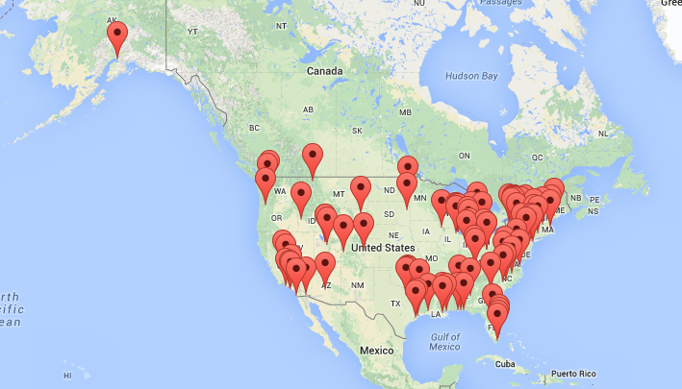
YEA Headquarters
Founded in 2004 at the University of Rochester with support from the Kaufmann Foundation
Currently 94 Chapters in the USA
Notes:
Goal & Mission
YEA! Mission:
Develop and deliver experience-based entrepreneurship programs to young people to:
Enable them to transition successfully to adulthood;
Help them to pursue their dreams by harnessing their creativity and energy;
Help them transform their ideas into tangible enterprises that create economic and social value for a better world;
Develop the character of tomorrow’s leaders based on personal principles and values;
Enable educational institutions and Chambers of Commerce to provide successful and effective entrepreneurship programs for middle and high school students;
Create a culture of innovation in schools and communities across the nation; and
Foster the entrepreneurial mindset in young people, educators, and community members.
YEA! Vision: To be a leader in establishing innovative, experiential entrepreneurship programs for middle and high school students, delivering these programs through colleges and universities, and in high schools and middle schools throughout the country, in close cooperation with local community and business leaders and their organizations. To partner with like minded organizations to effectively deliver entrepreneurship education to young people across our nation.
YEA! provides a focused introduction to the business world, combining a dynamic, proven curriculum with the experiences of local leaders of industry, community members, educators and entrepreneurs. The goal of all YEA! classes is for each student to successfully launch their own business.
The Young Entrepreneurs Academy, Inc. (YEA! Inc) is a charitable, tax-exempt organization under Section 501c (3) of the Internal Revenue Code.

Slide 4
YEA! At MVCC - By the Numbers
30 WEEKS
MAX OF 22 STUDENTS
3 INSTRUCTORS
6 FIELDTRIPS
40+ GUEST SPEAKERS, DESIGNERS, MENTORS, ETC.
3 MAJOR EVENTS
5 MAJOR SPONSORS
Notes:
Instructors
Michelle Truett, 484 Design
Brett Truett, Softnose, Inc.
Joe Mandia, Hi-Rez Studios
Number of Students
We have the capacity to have up to 22 students.
2012-2013, 8 Students
2013-2014, 12 Students
Fieldtrips
The fieldtrips consist of trips to a Salon, County Clerk’s Office, a Franchised Business, a Broadway Theatre, “Cool Business” and a Sports Complex.
County Clerk’s Office
Delmonico’s Italian Steakhouse
F.X. Matt Brewery
John Latini Salon
PJ Green
Stanley Theatre
Utica Roasting Company
Utica Auditorium

Slide 5
GUEST SPEAKERS
Guest speakers present in class for about an hour on topics such as:
Law
Accounting
Insurance and Risk Management
Niche Marketing
Designations and Awards
Government Resources
Taxes
Social Entrepreneurship
Banking
Media Marketing
Additional Participants
Notary
Emcee for Investor Panel
Graphic Designers
Web Developers
Business Plan Reviewers
Local CEOs (for CEO roundtable)
Local Media Personalities

Slide 6
Curriculum
The Big Idea
The Business Plan & Pitch
The Launch!
Notes:
The Big Idea!
During these classes, the students will be brainstorming and identifying different skills, talents, interests and passions that they possess and how those intersect with a great business opportunity for them. The students in this first segment of the class will come up with great business ideas that they will perfect and ultimately launch by the end of the program.
“The Business Plan & Pitch”
During these classes, the students will be putting together their business plans based on their business ideas created in the previous weeks and preparing to pitch their plans for funding at the exciting Investor Panel Event! This segment teaches students the process of writing a complete business plan, how to meet deadlines and benchmarks, and how to polish and prepare their plans to pitch to a panel of investors for the hopes of getting funded.
“The Launch!”
During these classes, the students will be putting their business plans to action as they manufacture products, order equipment, perfect their services, and prepare to get their first real customers at the Trade Show Event! Students will open bank accounts, legally register their business name and actually complete the launch of their business. The students also will participate in the YEA! Saunders Scholars Semi-Finals and potentially Finals of the National College Scholarship Competition and compete for college scholarship prizes.

Slide 7
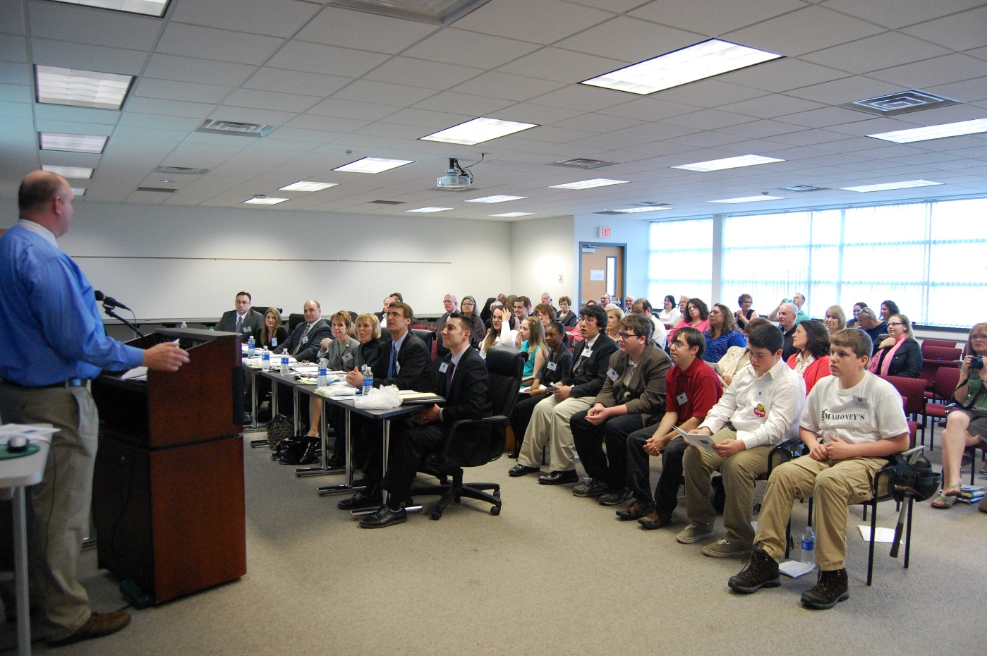
The Main Events
Investor Panel (aka, Shark Tank)
Trade Show Event
Graduation
Saunders Scholars Competition

Slide 8
Program Costs
  Franchising Fee $7,600.00
  Busing Fees for Field Trips
  Catering for Events
  Scholarships
  Instructors
  Assistant Program Manager
  Various Supplies, Printing Costs

Slide 9





Cultivation: Fundraising is Key
Greater Utica Chamber of Commerce
Beebe Construction
Mohawk Limited
First Source
M&T Bank
…Possibility for variety of community grants

Slide 10
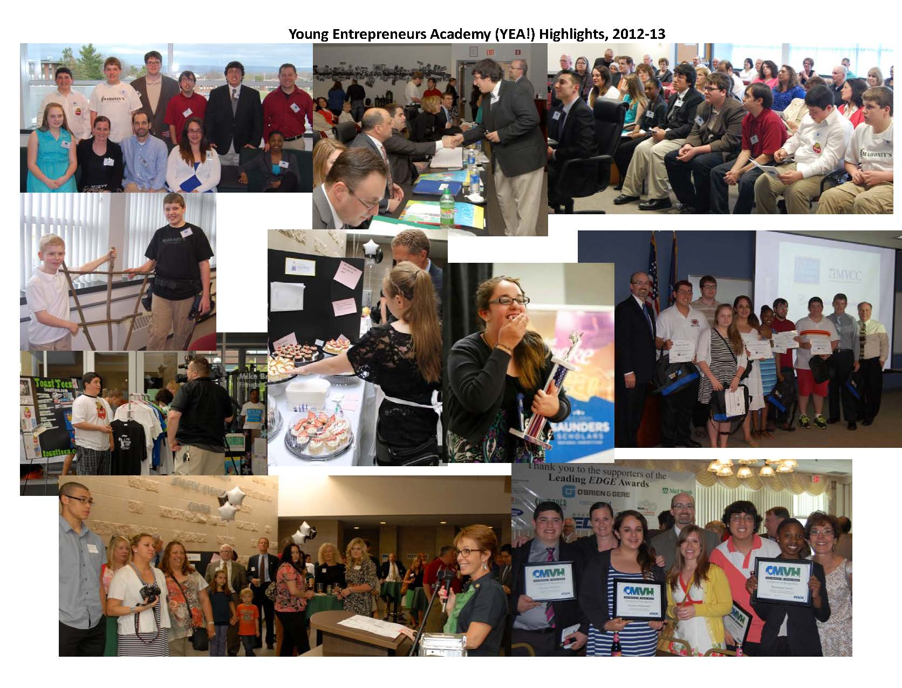
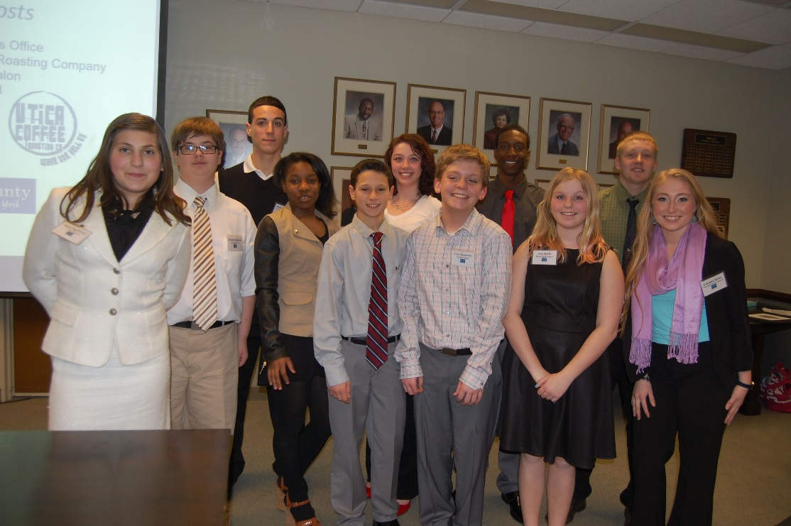
The Students

Slide 11


The Businesses

Slide 12
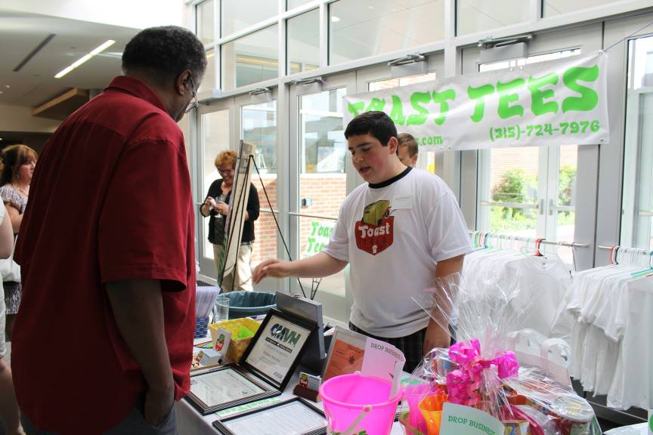
Student Profile: Michael Marchio
Notes:
Year 1:
Toast Tees, a product based company making custom t-shirts and other promotional items, received $590 in startup funds. Owner Michael Marchio is in tenth grade at New Hartford Senior High. Michael was also the recipient of the one year membership from the Mohawk Valley Chamber of Commerce.
Mikey has continued his business. He continues to sell his products and is a continued Chamber Member. He has expanded his business to include mouse pads, banners, frames, bags, mugs, pet accessories, and more.
Toast Tees is a mobile custom apparel manufacturer. Using heat transfer, Toast Tees can place single color or full color scheme pictures onto ultimately any piece of apparel. Toast Tees is also mobile because it has the ability to go to events and create T-Shirts onsite, using their mobile trailer or their table top heat transfer machine.

Slide 13
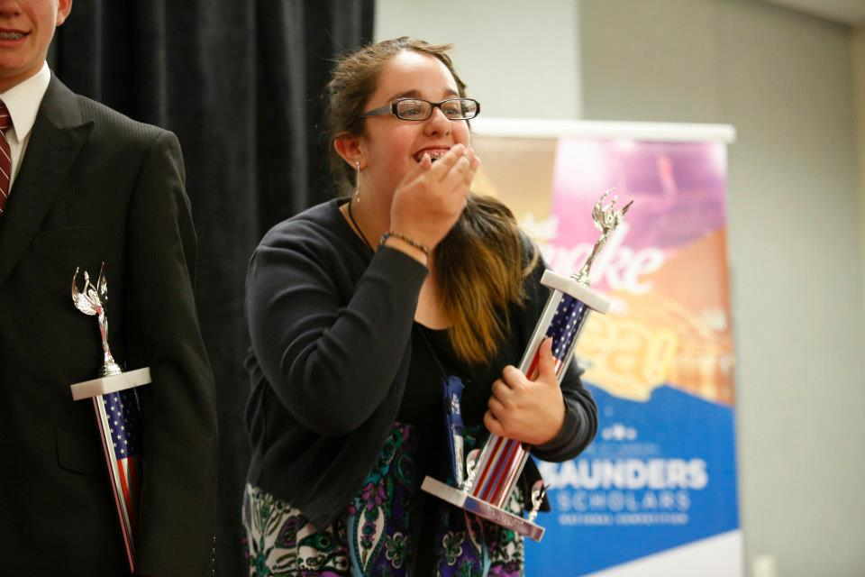

Student Profile: Yasmine Mohamed
Notes:
Balloonies, a balloon gift company, received $1000 in startup funds at the YEA MVCC Trade Show. Owner Yasmine Mohamed is in sixth grade at Otto Shortell Middle School in Oneida. Yasmine was selected as the Saunders Scholar Finalist by the Investor Panel. She goes on to compete in Rochester at the Saunders Scholar Event, with 41 other students from around the country. Yasmine also received a Presidential Scholarship from MVCC.
On Thursday, April 25th, young entrepreneurs aged 11-18, representing 41 communities from 16 states gathered in Rochester to pitch their big business ideas as a part of the Saunders Scholar Event. At the end of the night, she was one of only nine students selected to move forward to the finals, taking place Friday night, April 26. When all was said and done, Yasmine took 3rd place in the competition, winning a $20,000 scholarship to Rochester Institute of Technology, a fast pass to audition for the show “Shark Tank,” and the opportunity to be interviewed in an upcoming issue of “Teen Vogue.”
Balloonies is a sole proprietorship that makes and creates creative, unique and fun balloon gifts. The CEO, Yasmine Mohamed, came up with this idea after hearing person after person say they hate when they get a plain old gift basket. A gift stuffed inside a balloon would be a fresh new spin on the boring old “gift basket” in Central New York. A balloon gift is a customizable, fun alternative to the typical gift. You will see an instant smile come to the gift giver and the recipient when they pop the balloon gift!

Slide 14
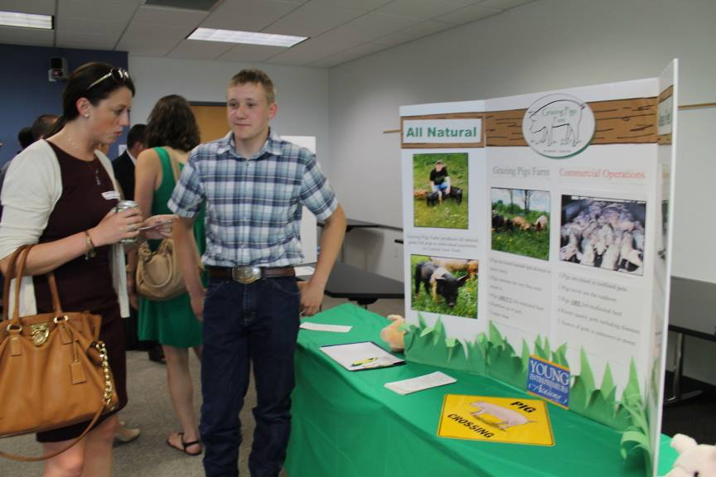
Student Profile: Charles Pilbeam
Notes:
Grazing Pigs Farm, all-natural grass fed pig farm, received $325 in startup funds. Owner Charles Pilbeam is 16 years old and is home schooled in Stittville, NY.
Grazing Pigs Farm received $325 from the Young Entrepreneurs Academy. The owner Charles Pilbeam has used the funds to pay $75 to pay a designer for the business log. He also spent $31.95 to purchase his DBA. He has used the remaining $218.05 to purchase a pig Port-A-Hut that cost $300. The pig Port-A-Hut is a building to keep the pigs out of the whether when they are in pasture that is moveable to allow Grazing Pigs Farm to move the pigs to different pasture sections.

Slide 15
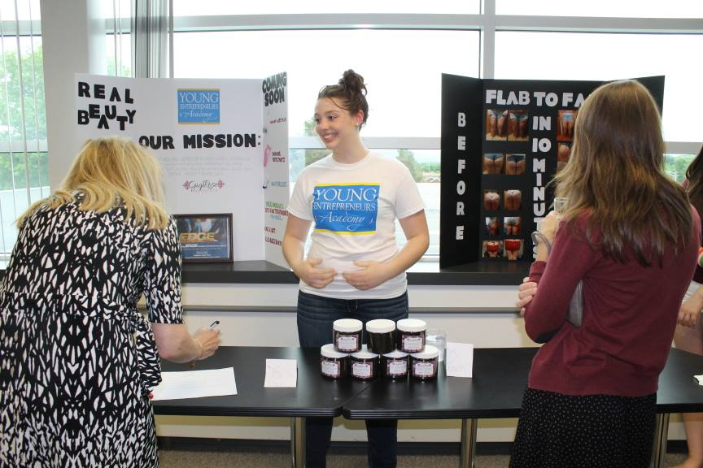
Student Profile: Jilianne Cady
Notes:
GigiRose Bodycare, a company producing all natural cellulite reducing cream, received $600 in startup funds. Owner Jilianne Cady is a 10th grader at Holy Cross Academy in Canastota. Jilianne was also presented with the one year membership to the Greater Utica Chamber of Commerce.

Slide 16
Economic Impact
  Keeping young people in the area will revitalize the region
  Building relationships between business, college, and community
  Fostering relationship between local business professionals and the community
  Foster relationship between MVCC and local school districts – exposing students to the college campus
  Success of program has encouraged sponsorship
  Great way for successful Alum to give back – financially and personally
Notes:
The MVCC/YEA! partnership has built and strengthened ties throughout the entire community. Alumni, sponsors, and local businesses have been able to participate in learning at MVCC in a way that wasn’t possible before. These local professionals are giving back to the students in a way that is meaningful and gratifying.
The YEA! program will help to keep young people in the area and in turn revitalize the community. The students are seeing that they can have success right here in their own backyards, while building relationships with local professionals. The program ties local business professionals to these young entrepreneurs, in turn helping the students to launch their own businesses and become impassioned local leaders.
By focusing on fostering the entrepreneurial spirit of the youth in our community, we are securing the future economic success of our community. This partnership maximizes the expertise and resources of both of our institutions. Mohawk Valley Community College, as the leading community college in the area, is able to offer excellence in education and educational facilities, while the Mohawk Valley Chamber is able to provide extensive linkages between local business owners, the college, and the students.

Slide 17
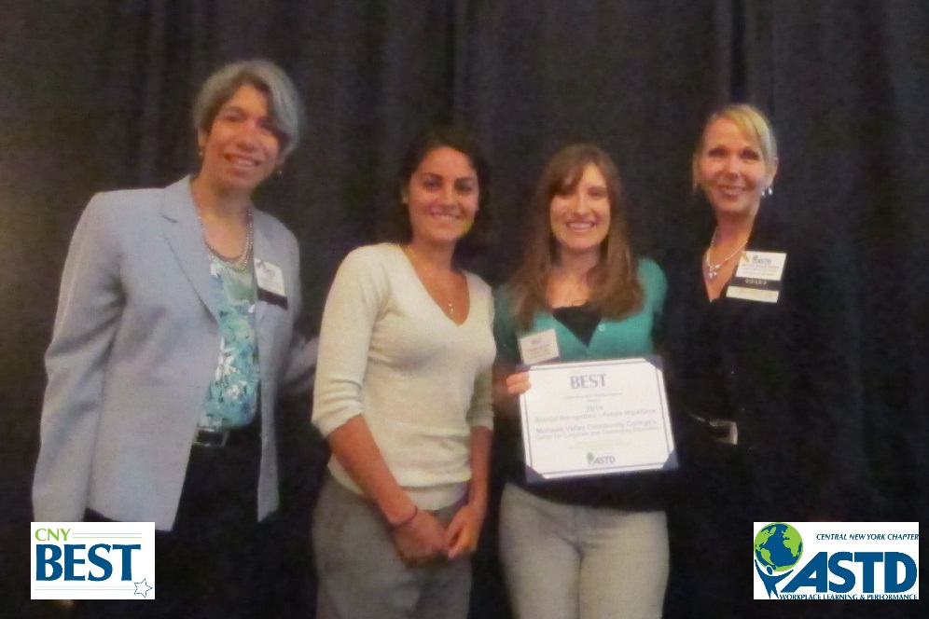
Recognition
2013 CEANY James C. Hall Program Award for Exemplary Business/Industry Linkage
2014 CNY ASTD Best Award – Special Recognition –
Future Workforce
Mohawk Valley Edge Special Recognition -
2013 and 2014

Slide 18
Challenges
Tough curriculum and content for age range of students
Recruiting is tough! Kids are overcommitted. So are parents!
Time and labor intensive
Associated costs and fundraising

Slide 19
Perks + Opportunities
Ready made curriculum and YEA! support
Building partnerships and great outreach: Alumni, Businesses, Chamber
Great Outreach: Schools, Community
Students learn real life skills: networking, public speaking, marketing, etc.
Gets kids comfortable with coming to our college campus = great college recruiting tool
Big events involve every aspect of the community
  Kids, parents, schools, media, business professionals, sponsors
“Feel Good” program

Slide 20
For More Information
Carolyn DeJohn: cdejohn@mvcc.edu
Tressa LaBella: tlabella@mvcc.edu
YEA! Headquarters:
http://www.yeausa.org
Questions?

